Slide 1
NMR spectroscopy Monitoring
of H/D Exchange in Aqueous Solutions of Ionic Liquids Forming Hydrogen Bond
A Role of Anions, Self-Aggregation, and Mesophase Formation
Vytautas Klimavičius
Vytautas Balevičius
Vilnius University, Faculty of Physics, Vilnius, Lithuania

Slide 2
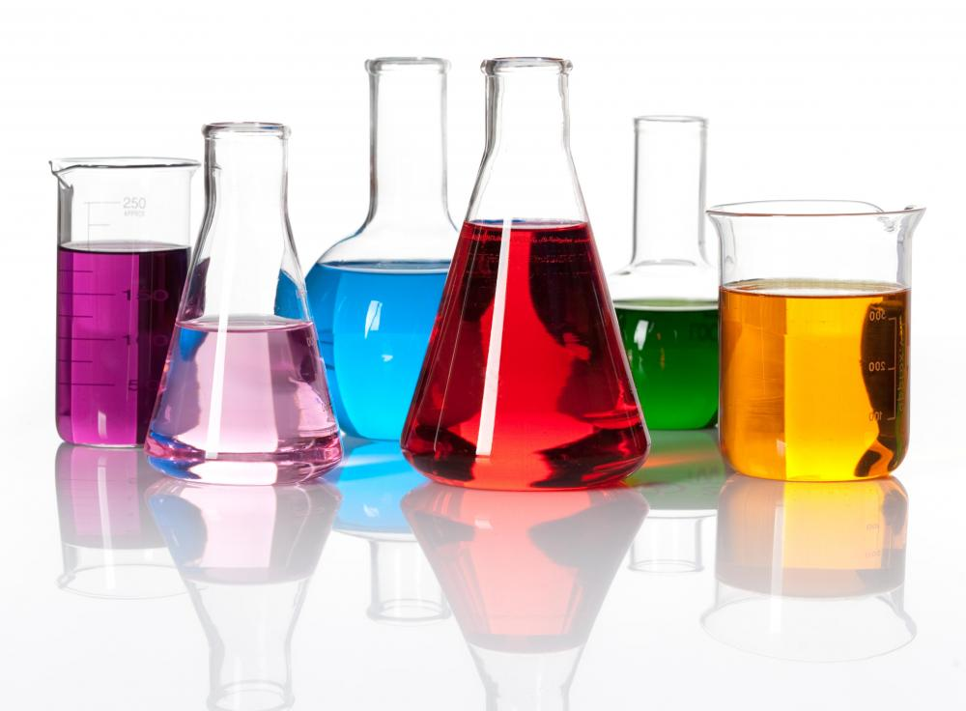
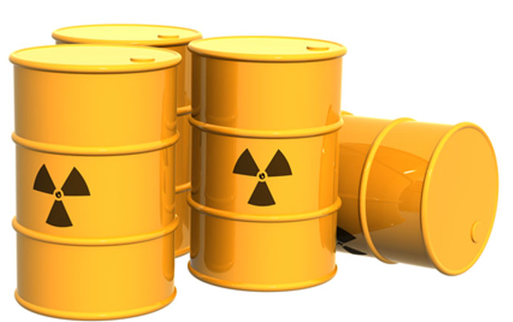
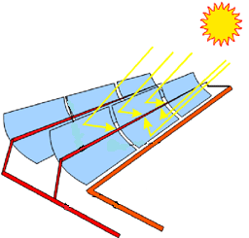
An ionic liquid is a liquid that contains essentially only ions. In the broad sense – molten salts, however, the term "ionic liquid" is commonly used for salts whose melting points below 100 °C.

Slide 3
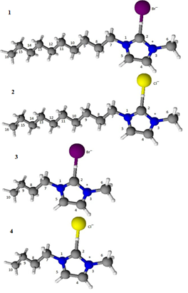
1-decyl-3-methylimidazolium chloride – [C₁₀mim][Cl]
1-decyl-3-methylimidazolium bromide – [C₁₀mim][Br]
Inoue, T.; Dong, B.; Zheng, L. Q. J.ournal of Colloid and Interface Science, 307, 578 – 581 (2007)

Slide 4
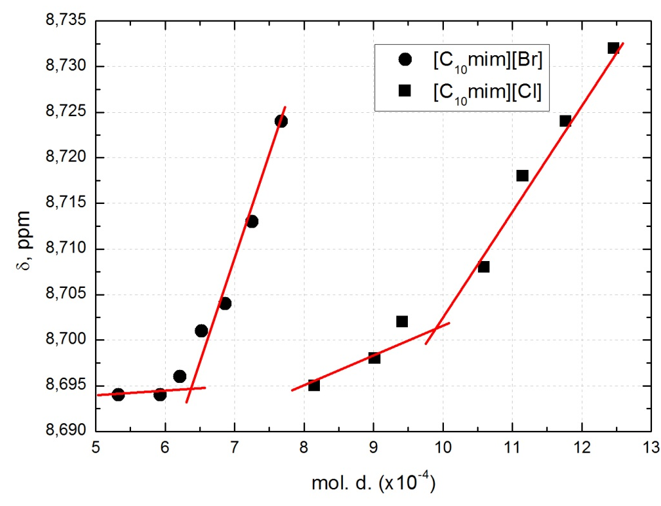
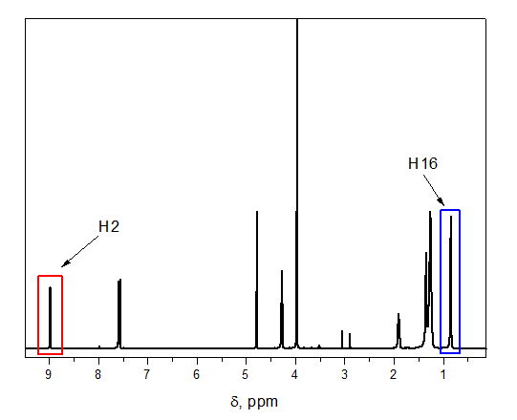
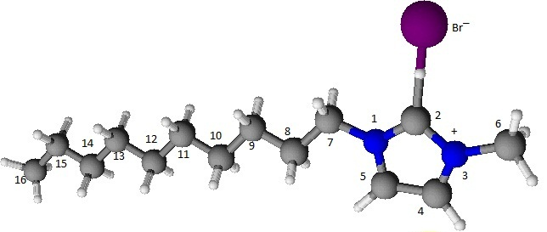
10⁻⁴ mol.fr.
10⁻² mol. fr./ 0,4 mol. fr.
$$\frac{I(H2)}{I\left(H2\right)+I(H16)}$$
0,4 mol.fr. [C₁₀mim][Cl/Br] D₂O
no H/D exchange
Cl⁻/Br⁻

Slide 5
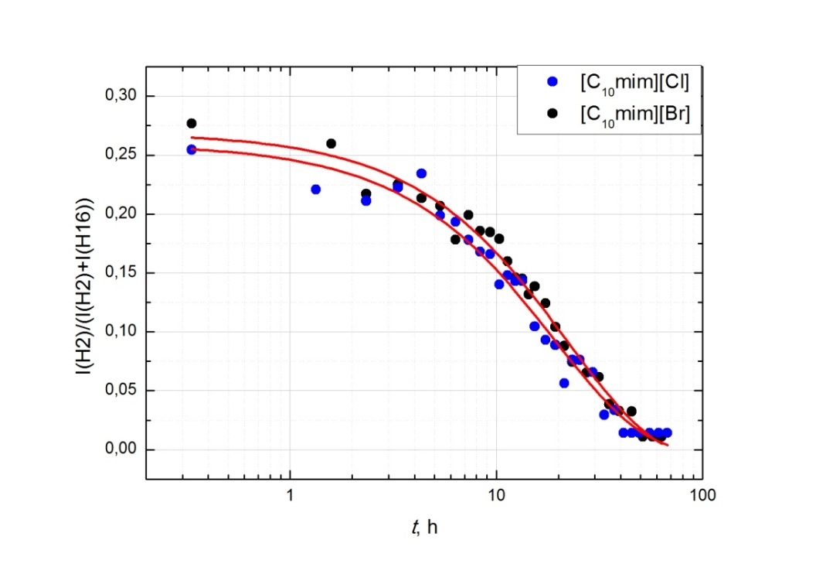
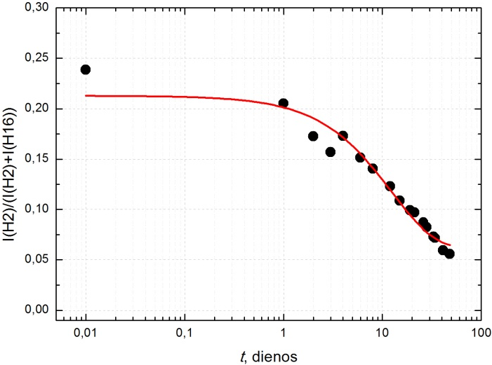
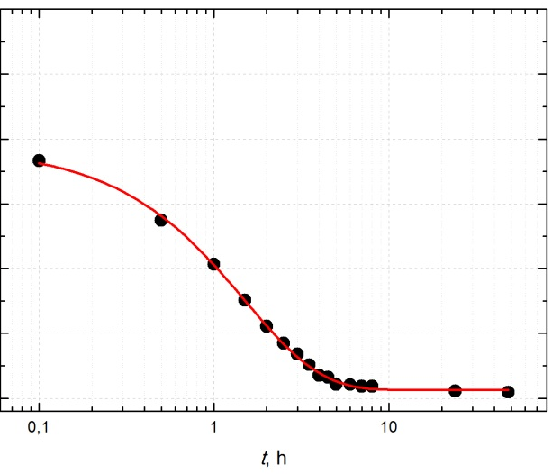
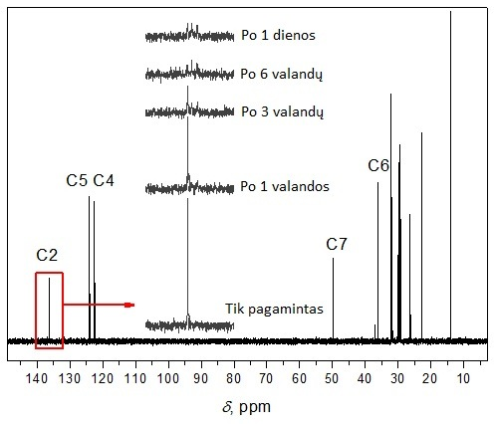
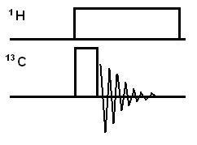
[C₁₀mim][Cl]
[C₁₀mim][Br]
10⁻⁴ mol. fr.
10⁻² mol. fr.
8–10 hours
2 days
> 50 days
10⁻² mol. fr.
Cl⁻/Br⁻
Cl/Br
Deuterium I=1
S=2nI+1=3
0,25 ppm – 0,02 ppm

Slide 6
In aqueous solutions with [C₁₀mim][Cl/Br] H/D exchange is possible
The H/D rate is dependant on concentrations and anion.
No H/D exchange reactions in Liquid Ionogel phase.
Vytautas Klimavicius, Zofia Gdaniec, Jonas Kausteklis, Valdemaras Aleksa, Kestutis Aidas, Vytautas Balevicius, NMR and Raman Spectroscopy Monitoring of Proton/Deuteron Exchange in Aqueous Solutions of Ionic Liquids Forming Hydrogen Bond: A Role of Anions, Self-Aggregation , and Mesophase Formation, The Journal of Physical Chemistry B 117, 10211 – 10220 (2013)

