Slide 1
Mechanical implementation of business process reengineering in the business entities
Dr.oec., prof. Marga Živitere
Dr.oec., as. prof. Viktoriia Riashchenko
phone: +37167100690
mob.: +37126008383
E-mail: viktorjas@gmail.com

Slide 2
Each process has its purpose which is a measure of its effectiveness - how best the process leading to its achievement.

Slide 3
1. Creation (design) of future business processes

Slide 4
2. Diagnostics business process management

Slide 5
3. Change (adaptation) of business processes

Slide 6
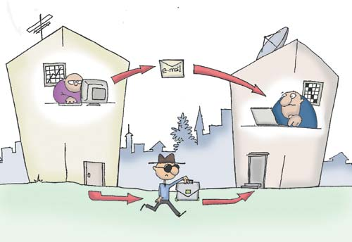
4. Business Process Optimization

Slide 7
A. Elaborate proposals for the optimization of business processes

Slide 8
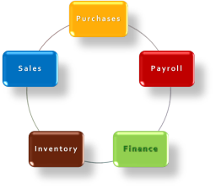
B. Company developed the scheme of information flows to streamline business processes

Slide 9
C. Regulation scheme

Slide 10
D. Optimizing the organizational structure

Slide 11
5. Documenting business processes

Slide 12
Reengineering
Helps to transfer management
Approach frees up additional resources
Approach that focuses on the growth of investment activity
Creates the prerequisites for the growth of innovation activity

