Slide 1
Website evaluation models and acceptability factors
K.Vipartienė, E. Valavičius

Slide 2
How to create an acceptable website for an enterprise?
Step 1: we hire webdesigners.
Step 2: we give a task for them - to create a perfect website.
Step 3: we get a website (see next slide).

Slide 3
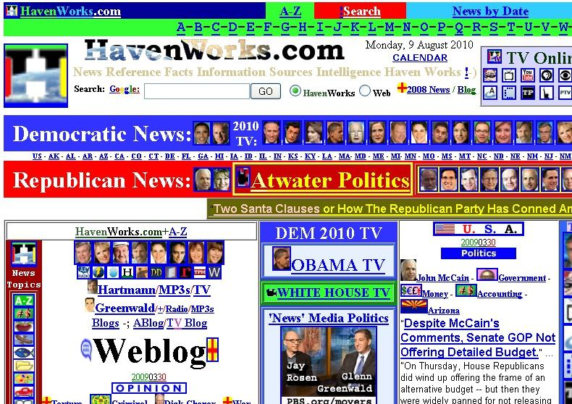

Slide 4
What’s wrong?
We cry - you created an awful, ugly, terrible website.
They say - we created an awful, magnificent, colorful, multifunctional website.
How to evaluate a website?
Our God is a Visitor. We have to ask him.

Slide 5
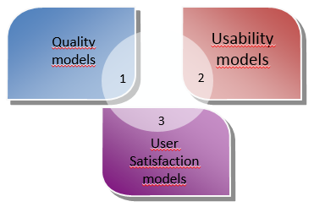
Publications about evaluation of educational, informational, governmental websites use 3 groups of models:

Slide 6
Quality model I
The first model contain 5 groups of criteria:
Visibility (availability of website for wide public): links, ads, publications and press reviews etc.
Perception (user comfort): accurate names of hyperlinks, clear current position of visitor, “less clicks is better”, alternative text for objects.
Technics: permanent website address, time of response and time of download, colour of links.
Contents: reliability of info, relevance to the purpose, freshness, dates, interactive feedback, archive.
Services: qualitative if provided in terms and users are willing to use.

Slide 7
Quality model II
Created for non-profit websites. Groups of criteria:
Usability - Site map, Feedback, Languages support, Navigation, Search.
Reliability - Browsers compatibility, Links Quality.
Performance - Download time, Quick access page.
Accessibility - Global site understandability, Readability, Simplicity, Fonts and Colours.

Slide 8
Quality model III
Created for multidimensional websites. Groups of criteria:
Contents - Accuracy, Completeness, Consistency, Updates, Syntax, etc.
Services - security, reliability, privacy, functionality, effectiveness, accuracy, availability, time of response, empathy, reputation, personalization.
Criteria of this model can be evaluated using 3/5 point Likert scale.

Slide 9
Quality model IV
Created for informational and public websites. Groups of criteria:
Layout.
Contents - relevance, completeness and accuracy, understandability and languages.
Navigation - ease of use, quality of the first page, structure, links, speed, search ability.

Slide 10
Usability models
A model with 3 categories:
Simplicity of navigation, Speed, Interactivity.
A model with 5 categories:
Content, organisation and readability; Navigation and links, User interface design, Performance and effectiveness, Educational information.
A model with 7 categories:
Colours and fonts, Friendliness, Trustworthiness, Graphics and images, Interactivity, Easy of use, Download speed.

Slide 11
Satisfaction models – 4 categories
The first model:
Quality of information, Quality of system, Perceived usefullness, Social impact (user perception of the others tend to use the website).
The second model:
Layout, Information, Connection, Language customization. Tested in Western Europe.

Slide 12
Conclusions: acceptability factors
Content
Clarity, freshness,
Ease of use, Navigation
Links, structure,
Speed
< 4 seconds to wait for next page
Design
Aesthetics
Understandability, format, adaptation
Consistency, accuracy
Site map, navigation path
Start page,
Categorization
Pictures
Layout
Colours and fonts

