Slide 1
TEXT ANALYSIS BY MEANS OF ZIPF’S LAW
Alina Andersen, Giedre Budienė, Alytis Gruodis
Vilnius Business College
Lithuania

Slide 2
The project is aimed at analysis of human language
The process:
artificial intelligence
language recognition
recognition of creating processes

Slide 3
Formulation of the project task
Formalized human language analysis and recognition
The task in the middle of the 20th century - conversation between human and robot , i.e. developing language programming applications
The task in the 21st century – analysing language using artificial intelligence

Slide 4
Specific questions to be answered:
Does the graphical ‘fingerprint’ exist for any text?
The graphical ‘fingerprint’:
related to the corpus/set of items
could be analyzed formaly
by computer programme

Slide 5
G. K. Zipf Human Behavior and the Principle of Least Effort (1949)
Human nature wants the greatest outcome for the least amount of work
The law states that people will naturally choose the path of least resistance or "effort“

Slide 6
Zipf's law (1)
the frequency of any word in a large corpus is inversely proportional to its rank in the frequency table
only a few words are used very often, many or most are used rarely

Slide 7
Zipf’s law (2)
Count number of words in an English book
Order the words by their frequency of appearance
Found that the most frequent word
appears twice as often
as next most popular word,
three times as often
as 3rd most popular, and so on.

Slide 8
Zipf’s law (3) Brown Corpus
The is the most frequently occurring word,
accounts for nearly 7% of all word occurrences (69,971 out of slightly over 1 million words).
Of is the second-rank word
accounts for slightly over 3.5% of words (36,411 occurrences),
And has 28,852 occurrences.
Only 135 vocabulary items are needed to account for half the Brown Corpus.

Slide 9
Zipf’s law (4)
n
Brown corpus

Slide 10
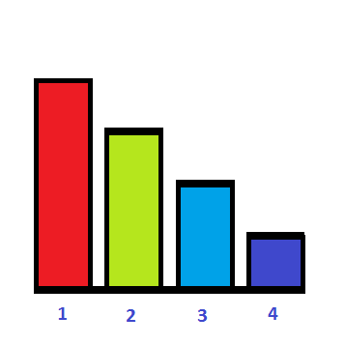
Zipf’s law (5)
Ranking of items
k → ω(k)
1 → ω(1)
2 → ω(2)
3 → ω(3)

Slide 12
George Kingsley Zipf
Frequency is inversely and linearly related
to rank.

Slide 13
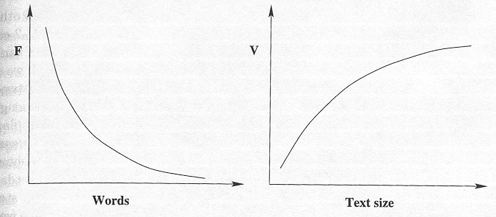
Power Law
Hyperbolic function
Inverse hyperbolic function
Zipf
Heap

Slide 14
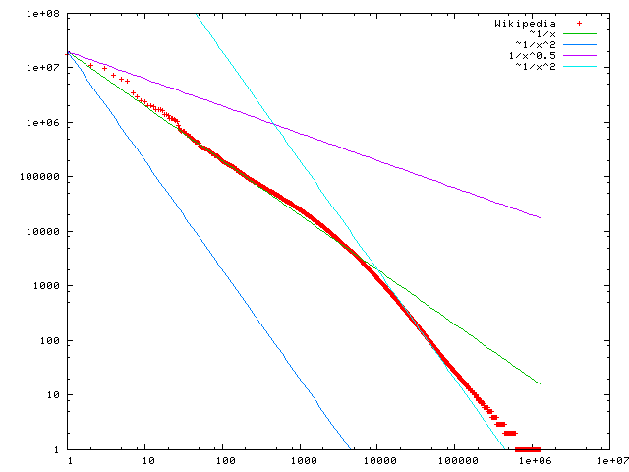
Wikipedia content

Slide 15
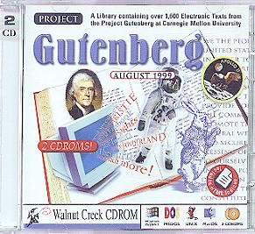
www.gutenberg.org

Slide 16
OSCAR WILDE
The Picture of Dorian Gray
CHAPTER 1
The studio was filled with the rich odour of roses, and when the light
summer wind stirred amidst the trees of the garden, there came through
the open door the heavy scent of the lilac, or the more delicate
perfume of the pink-flowering thorn.
From the corner of the divan of Persian saddle-bags on which he was
lying, smoking, as was his custom, innumerable cigarettes, Lord Henry
Wotton could just catch the gleam of the honey-sweet and honey-coloured
blossoms of a laburnum, whose tremulous branches seemed hardly able to
bear the burden of a beauty so flamelike as theirs;
.... .... ....

Slide 17
Analysis (1):
1. All the words indentified (a word is combination of letters followed by a space)
2. Grammatical forms (function words) not excluded
3. Syntactical and puctuation marks removed
4. 's not excluded
5. Decapitalization performed
6. Calculation of word frequency and ranking was performed

Slide 18
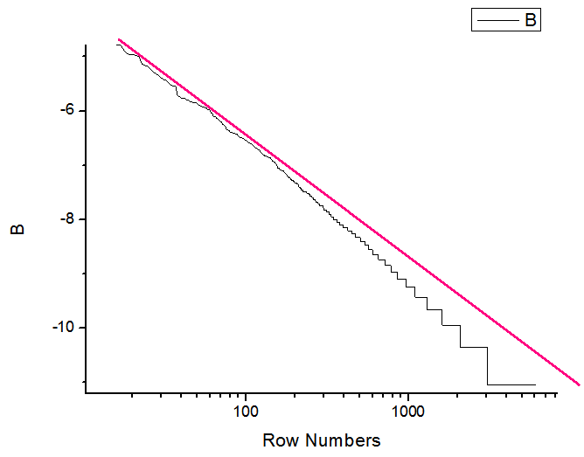
Analysis (2):
Frequency dependence on item rank
totally 60000 items (words)
200 words are used frequently
the other words are used rarely
the text is rather difficult for an average reader.

Slide 19
Properties of power-law distributions
Findings:
Asymmetric distribution
Most words are very rare
Half the words in the corpus appear only once, called hapax legomena (Greek for “read only once”)
The diagram shows a “heavy tailed” distribution since most of the probability mass is in the “tail”

Slide 20
Findings from analysis of the novel by the Zipf law:
No one-line distribution for all the corpus
Small vocabulary
Significant part of the items in the corpus appear only once
How to estimate the ratio of order / disorder?

Slide 21
Shenon function
Shenon entropy is
the average unpredictability
in a random variable
equivalent to its information content.

Slide 22
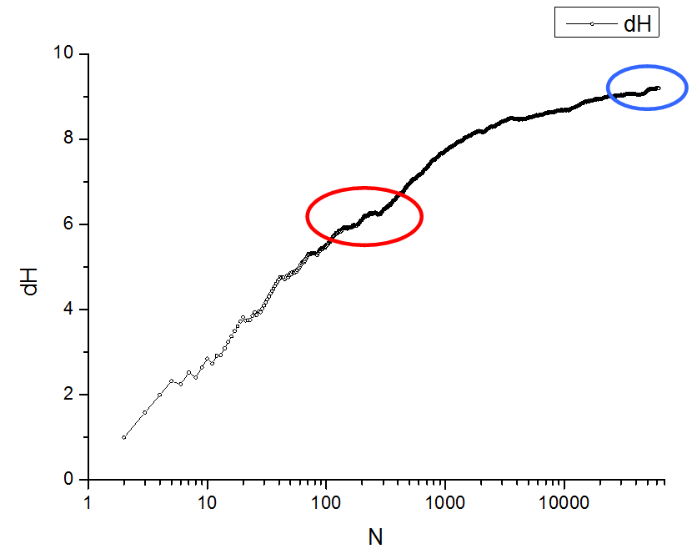
Shenon entropy dependence
on item number N

Slide 23
Shenon entropy
Presented dependance is similar to heap function (vocabulary grow)
Several exeptions are present
How to combine the such both dependencies ? (shenon function and zipf function)

Slide 24
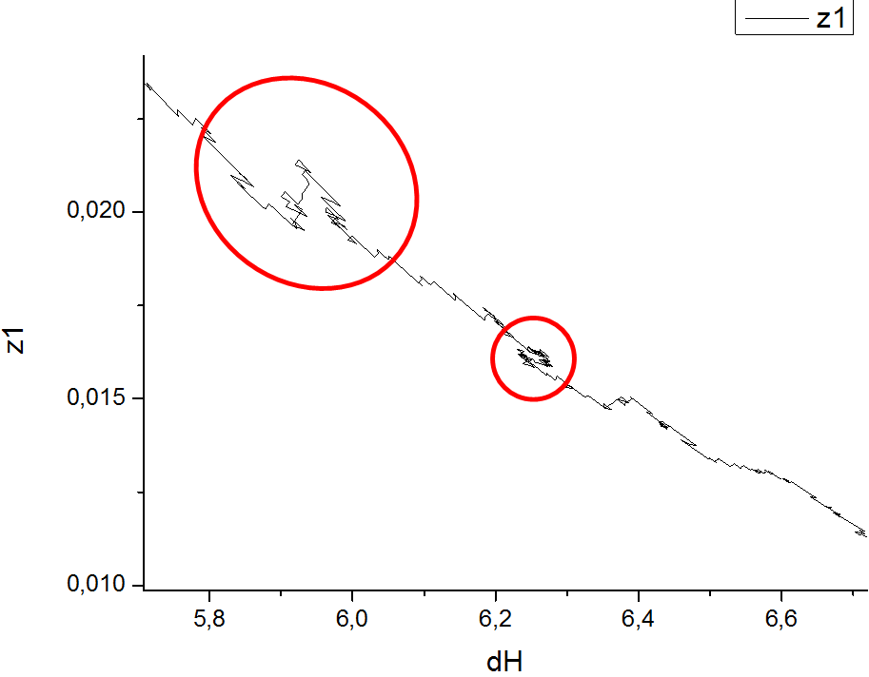
ZS-dependency (1):
Zipf constant dependency on corresponding Shenon value for current item
Entropy increases by increasing number of items. While entropy increases zipf function decreases.
Intuitively perceived stylistic beauty is proportional to the number of rarely used words.

Slide 25
ZS-dependency (2):
Several sophisticated figures
Reswitching of content and context
Use of new vocabulary

Slide 26
ZS-dependency (3):
Reswitching of content
New paragraph
New morphological content
PORTRAIT - LANDSCAPE

Slide 27
Conclusions
For a very large corpus the Zipf curve for English has two slopes, β = 1 for rank < 5000 and β = 2 for rank >5000.
Several genres (lexical and morphological forms) are recognizable using mathematical tools.
Zipf and Shennon functions: significance of adjustable parameters for limited corpus.
Academic English via Modern English – entropy related problems.

Slide 28
Thank you!

